Slide 1
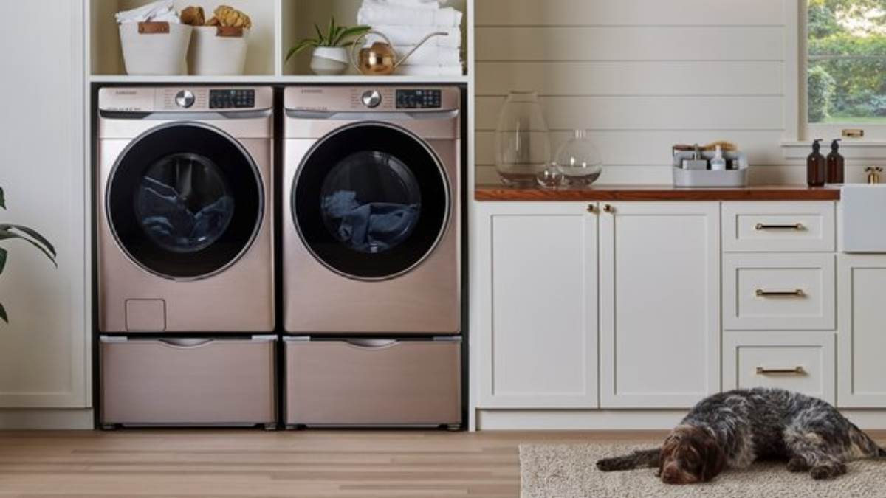

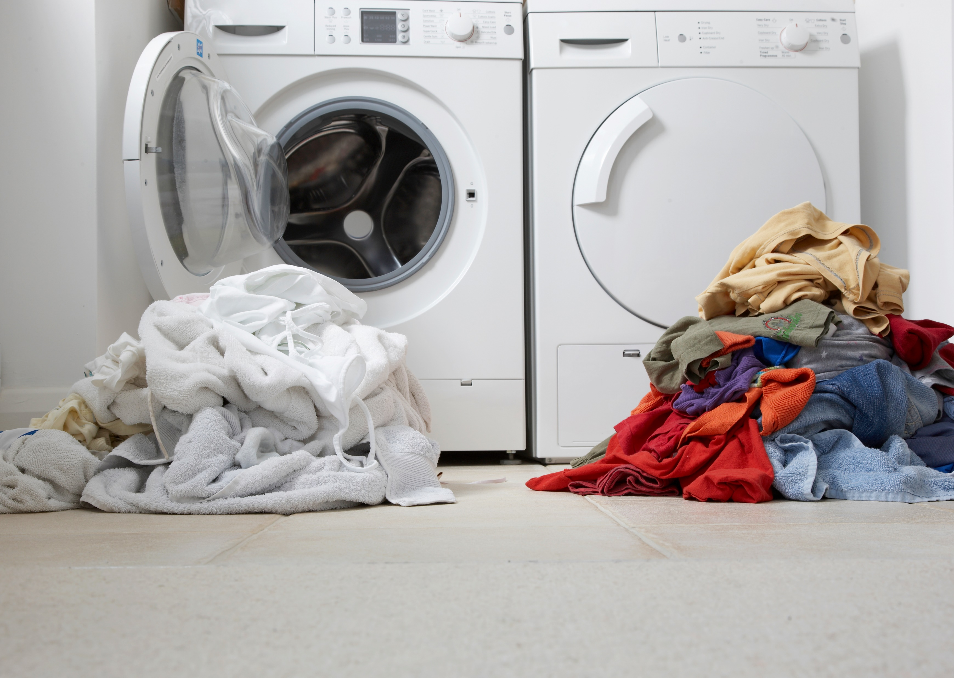
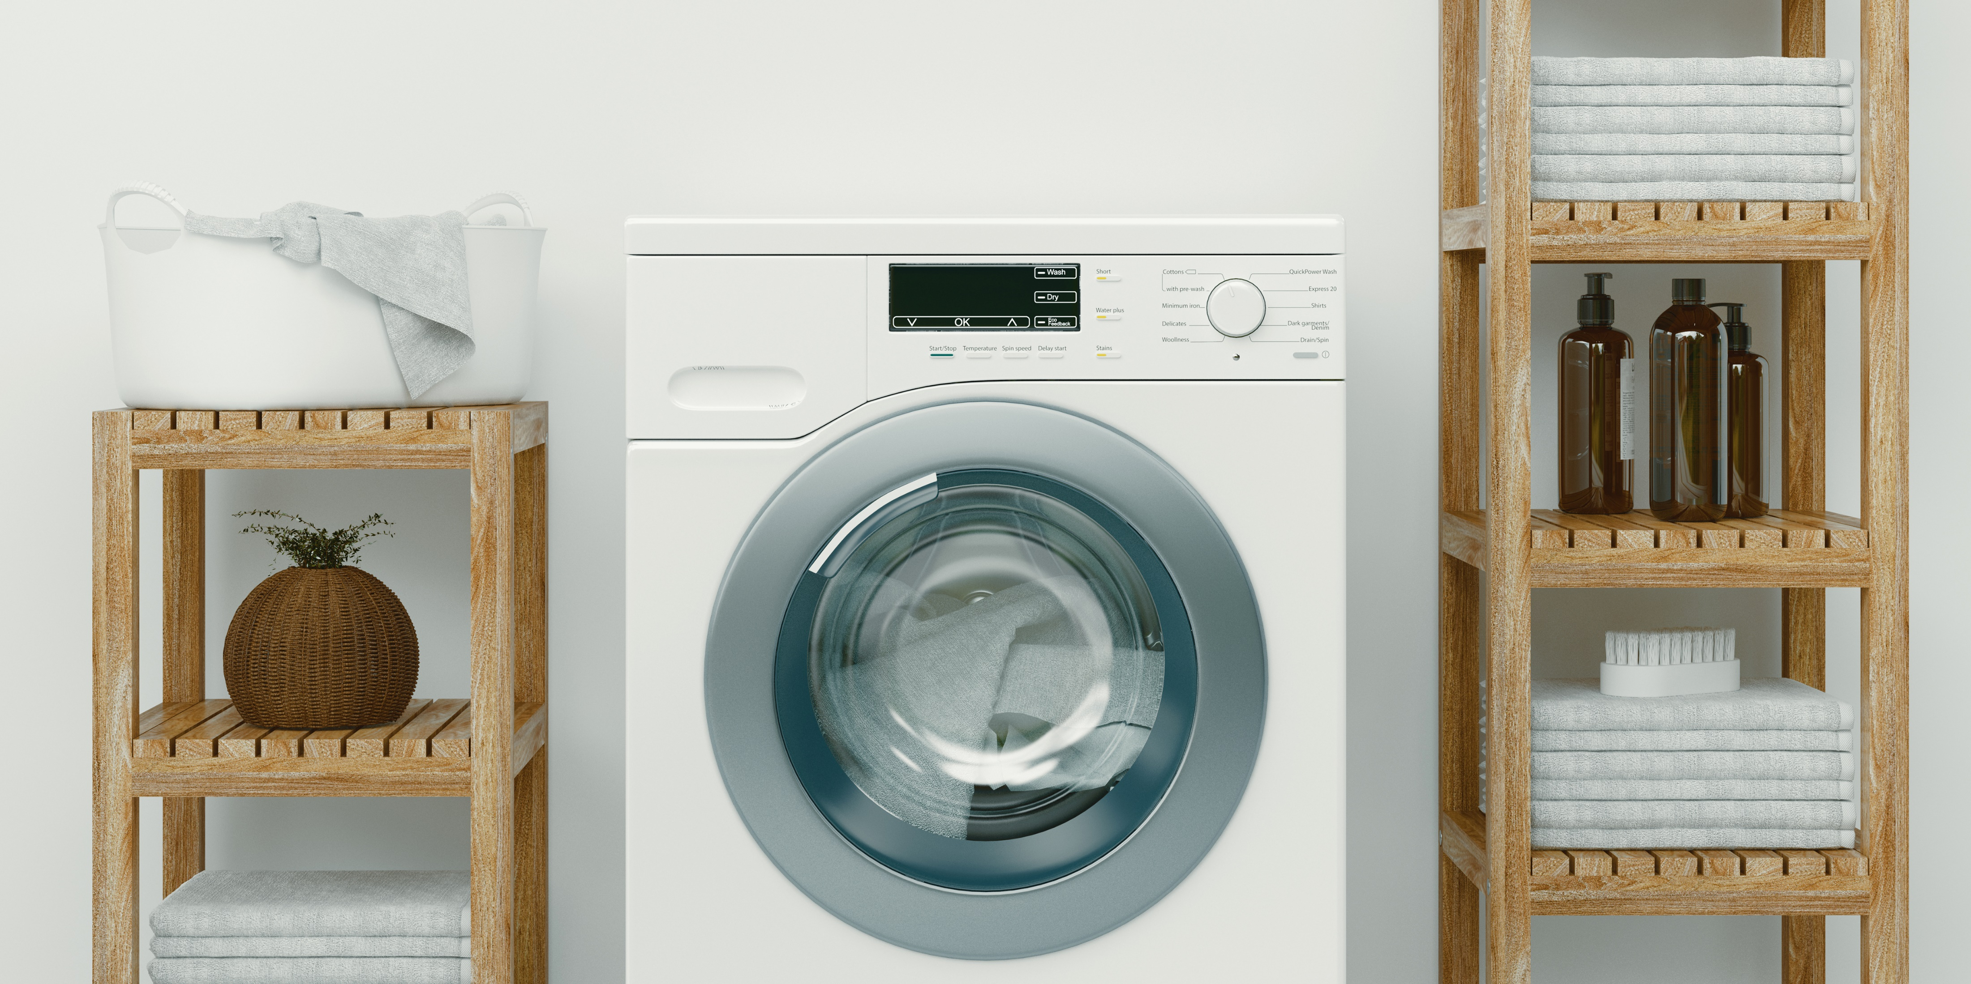

IFB Washing machines competitor Analysis
Ashish Kandpal 21230022474

Slide 2
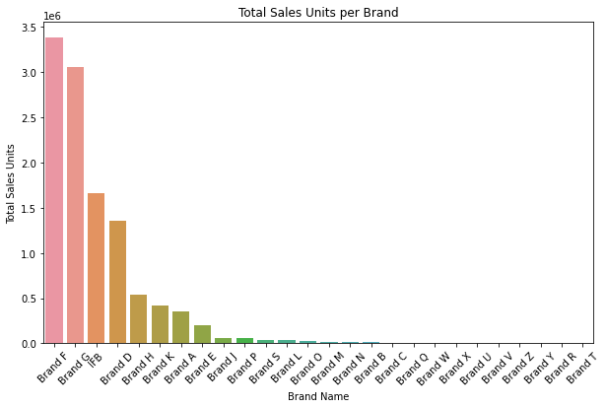
Brand F, G, IFB and D are the top 5 brands in sales units

Slide 3
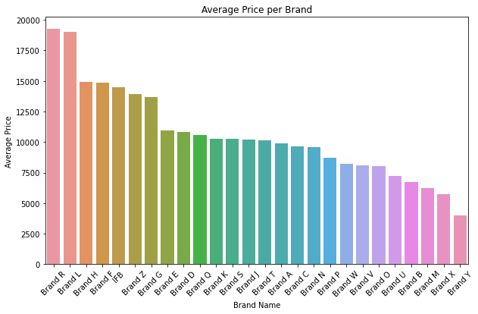
Average Price Per Brand

Slide 4
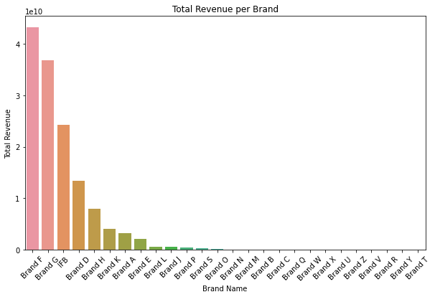
Top 5 Total revenue per brand: Brands F, G, IFB, D, and H.

Slide 5
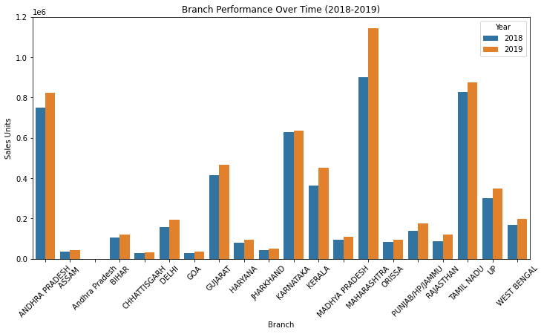
Branch performances (2018-2019): Maharashtra, Tamil Nadu, and Andhra Pradesh

Slide 6
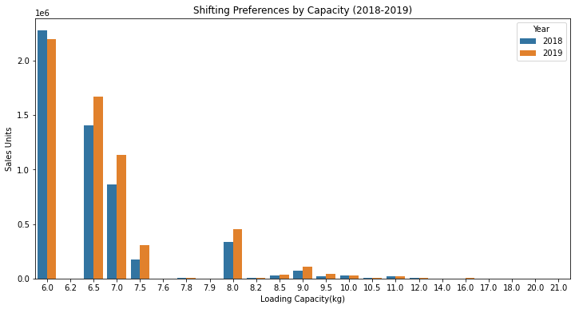
Loading Capacity Analysis In Washing Machines
In terms of loading capacity consumers dropped in for 6.0 kg washing machines in 2019,
However 6.5kg, 7.0kg, 8.0kg, and 7.5 kg units sold more in 2019 compared to 2018

Slide 7
Conclusion
Brands F, G, IFB, and D are the top 5 brands in sales units as per average price per brand: Brands R, L, H, F, AND IFB are the top 5 in average price.
Highest Total revenue per brand: Brands F, G, IFB, D, and H are in the top 5.
In Branch performances (2018-2019): Maharashtra, Tamil Nadu, and Andhra Pradesh are in the Top.
In terms of loading capacity consumers dropped in for 6.0 kg washing machines in 2019, however for 6.5kg, 7.0kg, 8.0kg, and 7.5 kg units sold more in 2019 compared to 2018.

